Slide 1

Chapter 6
IP Security
Henric Johnson
Blekinge Institute of Technology, Sweden
http://www.its.bth.se/staff/hjo/
henric.johnson@bth.se
Henric Johnson

Slide 2
Outline
Internetworking and Internet Protocols
IP Security Overview
IP Security Architecture
Authentication Header
Encapsulating Security Payload
Combinations of Security Associations
Key Management
Henric Johnson

Slide 3
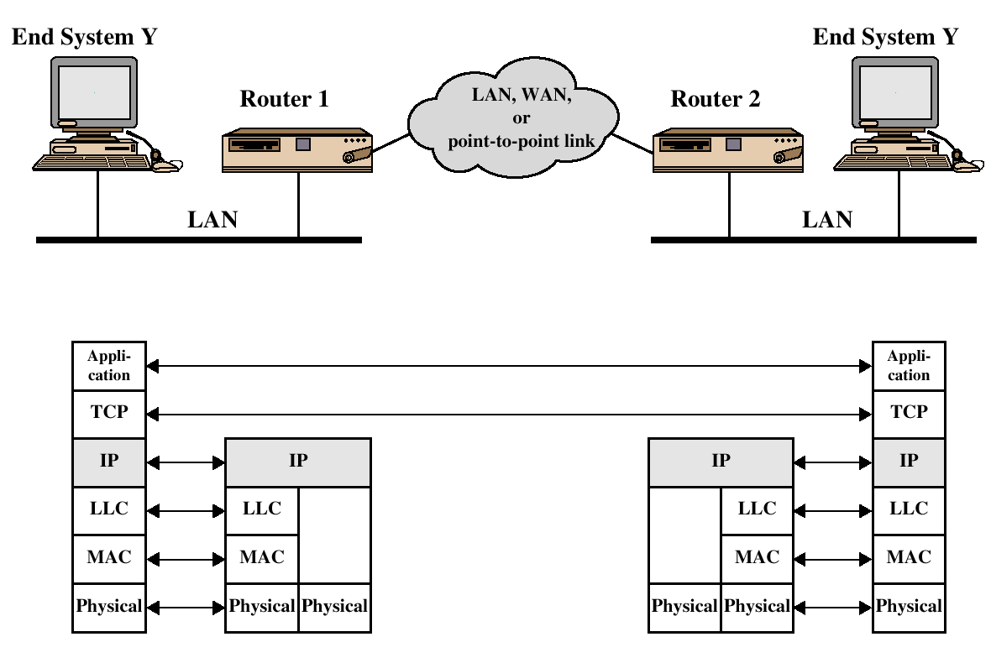
TCP/IP Example
Henric Johnson

Slide 4
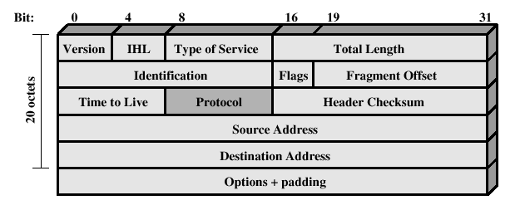
IPv4 Header
Henric Johnson

Slide 5
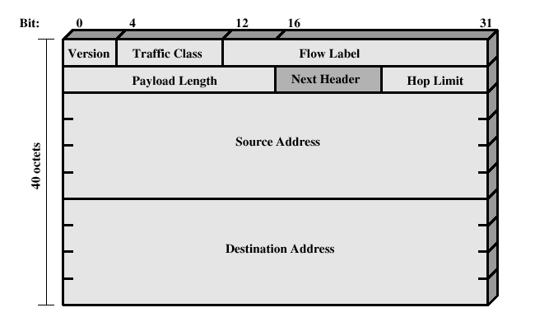
IPv6 Header
Henric Johnson

Slide 6
IP Security Overview
IPSec is not a single protocol. Instead, IPSec provides a set of security algorithms plus a general framework that allows a pair of communicating entities to use whichever algorithms provide security appropriate for the communication.
Henric Johnson

Slide 7
IP Security Overview
Applications of IPSec
  Secure branch office connectivity over the Internet
  Secure remote access over the Internet
  Establsihing extranet and intranet connectivity with partners
  Enhancing electronic commerce security
Henric Johnson

Slide 8
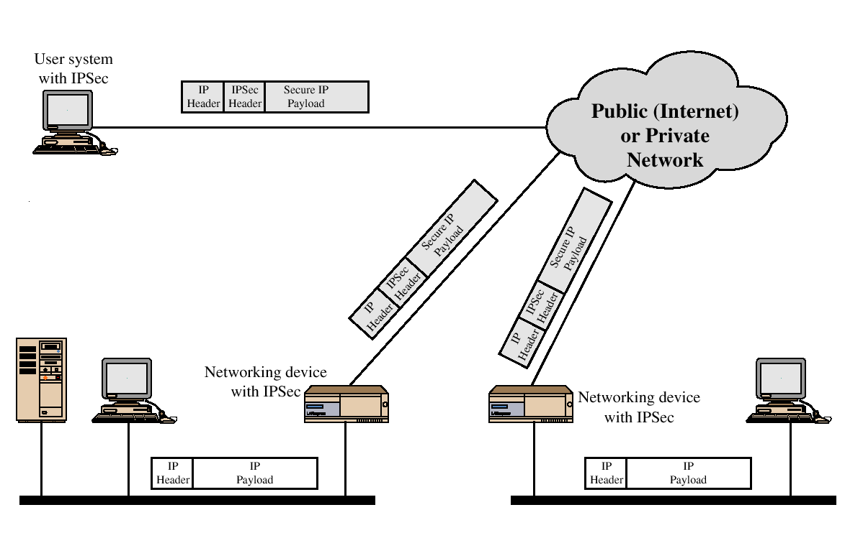
IP Security Scenario
Henric Johnson

Slide 9
IP Security Overview
Benefits of IPSec
  Transparent to applications (below transport layer (TCP, UDP)
  Provide security for individual users
IPSec can assure that:
  A router or neighbor advertisement comes from an authorized router
  A redirect message comes from the router to which the initial packet was sent
Henric Johnson

Slide 10
IP Security Architecture
IPSec documents:
  RFC 2401: An overview of security architecture
  RFC 2402: Description of a packet encryption extension to IPv4 and IPv6
  RFC 2406: Description of a packet emcryption extension to IPv4 and IPv6
  RFC 2408: Specification of key managament capabilities
Henric Johnson

Slide 11
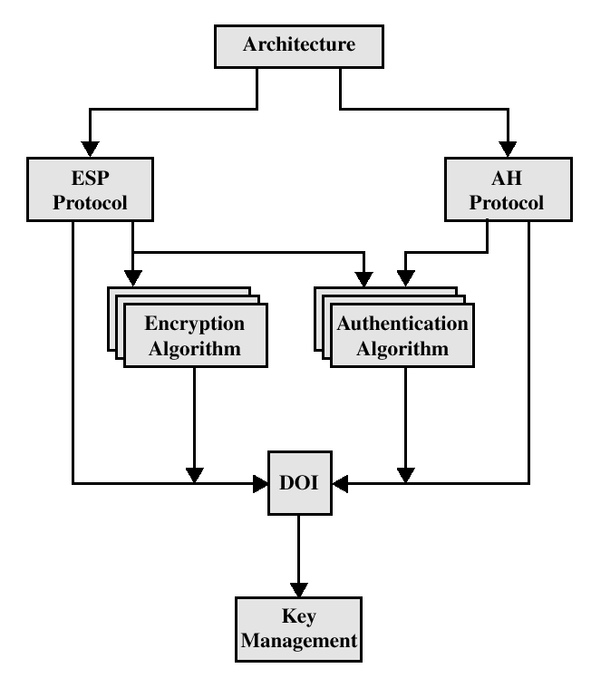
IPSec Document Overview
Henric Johnson

Slide 12
IPSec Services
Access Control
Connectionless integrity
Data origin authentication
Rejection of replayed packets
Confidentiality (encryption)
Limited traffic flow confidentiallity
Henric Johnson

Slide 13
Security Associations (SA)
A one way relationsship between a sender and a receiver.
Identified by three parameters:
  Security Parameter Index (SPI)
  IP Destination address
  Security Protocol Identifier
Henric Johnson

Slide 14
AH and ESP modes of operation
Transport mode
Tunnel mode

Slide 15
Modes
In tunnel mode an encrypted tunnel is establish between DTE AND DCE
It create ipsec tunnel between two ends
Tunnel mode is normally used between two routers,host and routers or router and host.
Generally it is not used between two hosts.

Slide 16
Modes
The transport mode does not hide the actual source and destination addresses.
They are visible in plain text.
In the transport mode Ipsec takes the transport layer payload, add ipsec heade and encrypt whole thing and then add ip header in not encrypted.
Transpor mode used between host to host.

Slide 17
 | Transport Mode SA | Tunnel Mode SA
AH | Authenticates IP payload and selected portions of IP header and IPv6 extension headers | Authenticates entire inner IP packet plus selected portions of outer IP header
ESP | Encrypts IP payload and any IPv6 extesion header | Encrypts inner IP packet
Henric Johnson

Slide 18

Before applying AH
Henric Johnson

Slide 19
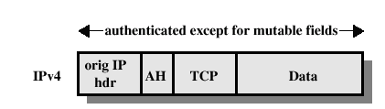
Transport Mode (AH Authentication)
Henric Johnson

Slide 20
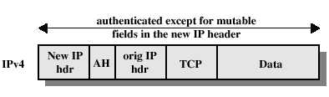
Tunnel Mode (AH Authentication)
Henric Johnson

Slide 21
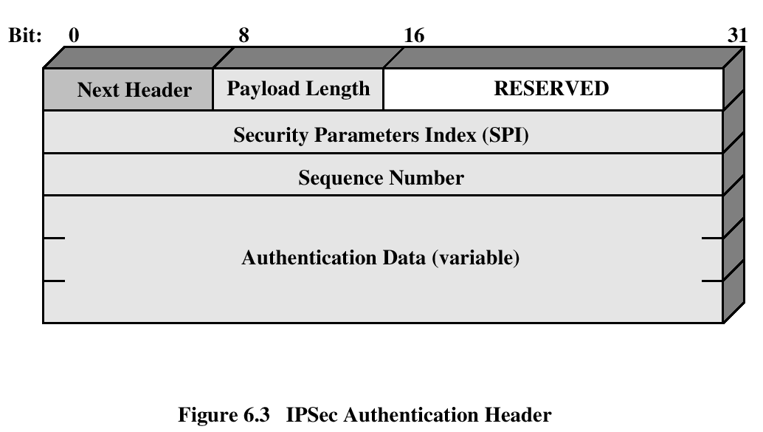
Authentication Header
Provides support for data integrity and authentication (MAC code) of IP packets.
Guards against replay attacks.
Henric Johnson

Slide 22
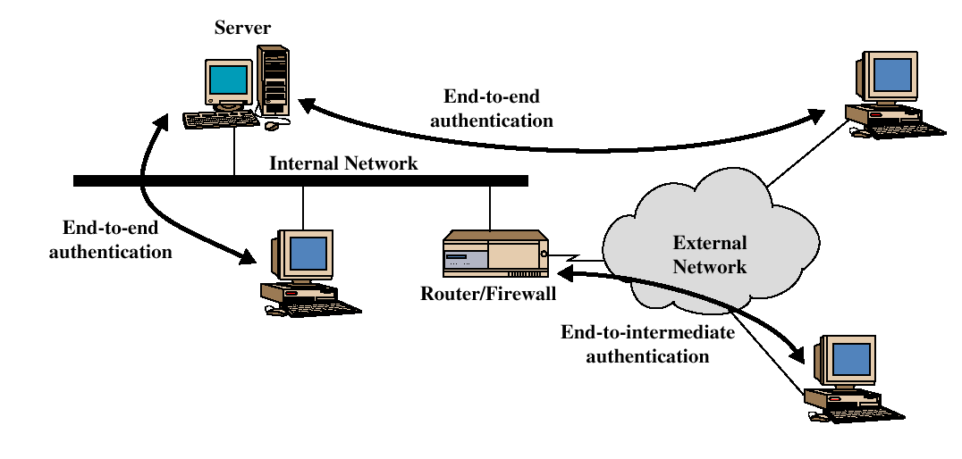
End-to-end versus End-to-Intermediate Authentication
Henric Johnson

Slide 23
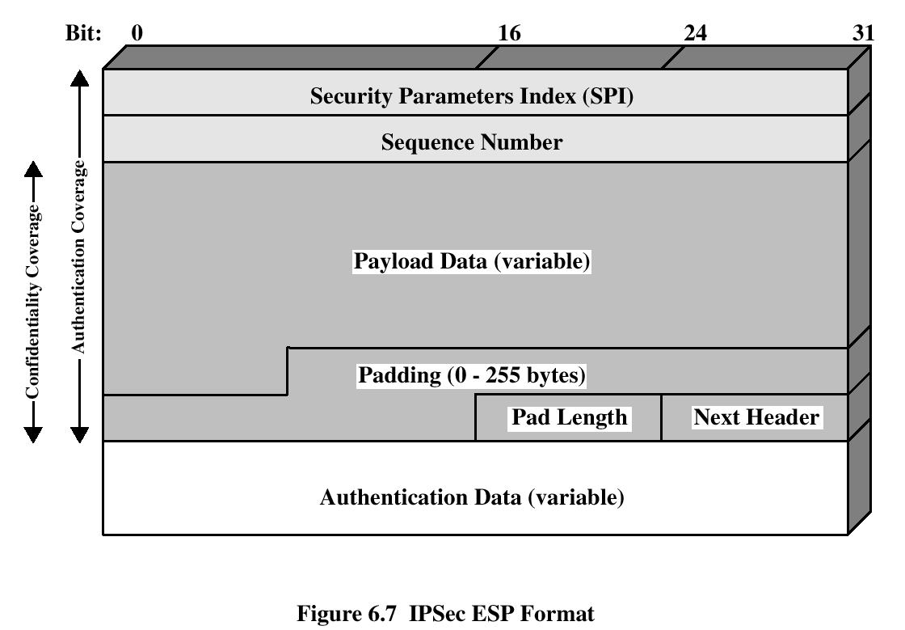
Encapsulating Security Payload
ESP provides confidentiality services
Henric Johnson

Slide 24
ESP
SPI= 32 Bits field, used for uniquely identify the SA For traffic to which datagram belong
Sequence number= 32 bit field,to prevent duplicate packets.
Payload data= transport layer segment or ip packet (encrypted)
Padding= add padding bits used by authentication algorithm
Padding length=no of padding bytes
Next header= types of encapsulated data in payload like 4 for tcp
Authentication data= contain integrity check value calculated by esp packet minius AH packet.
Henric Johnson

Slide 25
Encryption and Authentication Algorithms
Encryption:
  Three-key triple DES
  RC5
  IDEA
  Three-key triple IDEA
  CAST
  Blowfish
Authentication:
  HMAC-MD5-96
  HMAC-SHA-1-96
Henric Johnson

Slide 26

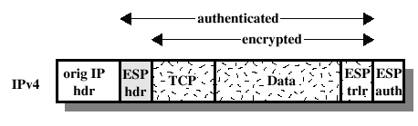
ESP Encryption and Authentication
Henric Johnson

Slide 27
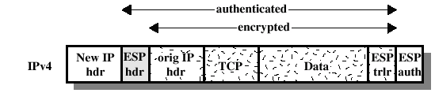
ESP Encryption and Authentication
Henric Johnson

Slide 28
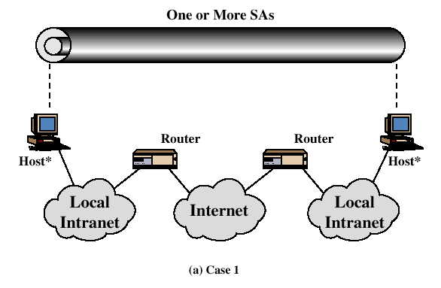
Combinations of Security Associations
Henric Johnson

Slide 29
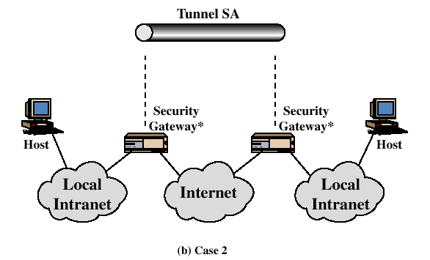
Combinations of Security Associations
Henric Johnson

Slide 30
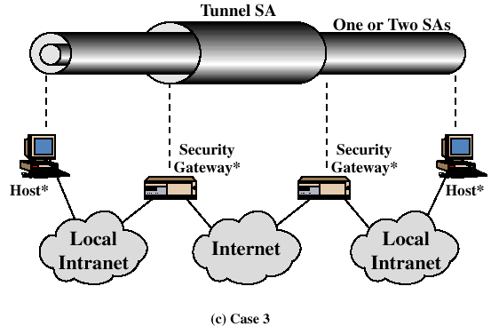
Combinations of Security Associations
Henric Johnson

Slide 31
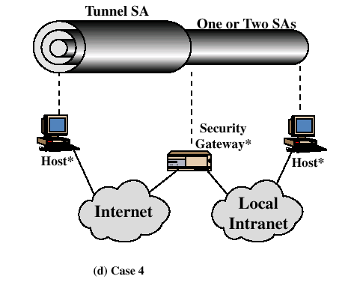
Combinations of Security Associations
Henric Johnson

Slide 32
Key Management
Two types:
  Manual
  Automated
    Diffie hellman
    Internet Security Association and Key Management Protocol (ISAKMP)
Henric Johnson

Slide 33
Oakley
Three authentication methods:
  Digital signatures
  Public-key encryption
  Symmetric-key encryption
Henric Johnson

Slide 34
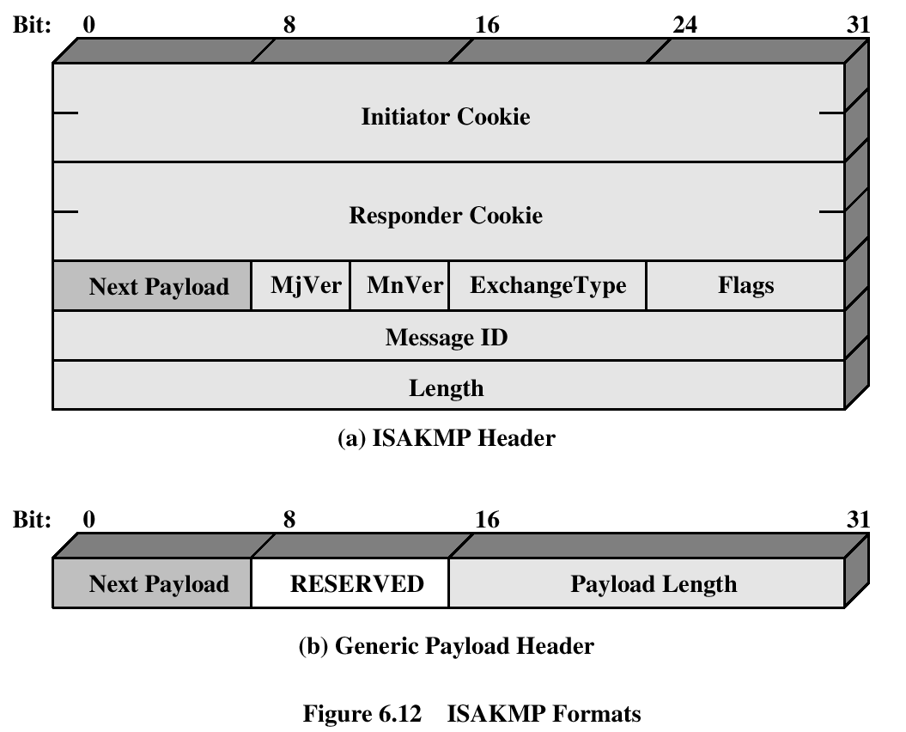
ISAKMP
Henric Johnson

Slide 35
Recommended Reading
Comer, D. Internetworking with TCP/IP, Volume I: Principles, Protocols and Architecture. Prentic Hall, 1995
Stevens, W. TCP/IP Illustrated, Volume 1: The Protocols. Addison-Wesley, 1994
Henric Johnson

